Slide 1
Cognition

Slide 2
Cognition
Cognition: the mental activities associated with thinking, knowing, remembering, and communicating.
Ideas, thoughts, concept formation, logic and reasoning, problem solving, decision-making, attention.
Cognition in psychology: scientific study of the mind and mental functions.

Slide 3
Categorical Thinking
Categorical thinking: mostly unconscious process of organizing people and objects into preconceived categories that are stored in our long-term memory.
People make sense of the world by putting things in categories.
People have a tendency to see patterns in what are actually random events.
People organize items into hierarchies.

Slide 4
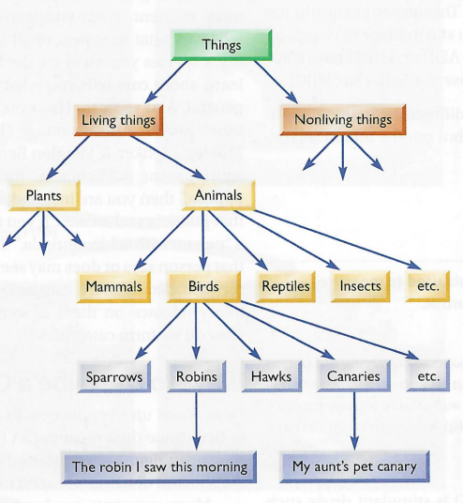
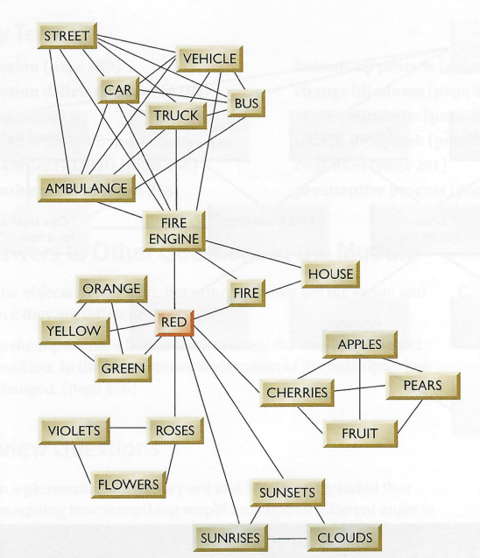
Categorical Thinking

Slide 5
Categorical Thinking
Brain organizes and interprets information very quickly.
Ambady & Rosenthal (1993)
Students shown video clips of university instructors.
Rated instructors independently.
Participants’ ratings similar to each other’s.
Participants’ ratings matched those of students in the class.
6 seconds, no sound.
Similar studies of high school teachers, courtroom judges, physicians.
15 seconds

Slide 6
Concepts
Concept: a mental grouping of similar objects, events, ideas, or people.
Categorizing/ grouping things based on common properties.
Allows us to apply what we already know to something new.
Provides stability in that non-identical things can be treated as identical.
Helps with communication between people.

Slide 7
Feature Set Theory
Organizing concepts based on features that items have in common.
Defining features vs. characteristic features.
Needs defining features.
Characteristic features optional.

Slide 8
Prototype Theory
Prototype: mental image or best example that incorporates all the features we associate with a category.
Prototype theory
There are no defining features.
Humans have a representation of attributes that tend to be true of the concept.
The more closely an item resembles the prototype, the more readily we recognize it (Platonic ideal).
Objects classified more loosely than in feature set theory.
More flexible theory of concepts.

Slide 9
Schemas
Schemas: a framework of related concepts.
Collection of knowledge and beliefs that directs behavior and guides expectation.
Role schema: norms and expected behavior from people with a specific role in society.
Event schema/cognitive script: behavioral and event sequences in daily activities.
Provide basis for anticipating the future, setting goals, and making plans.

Slide 10
Problem Solving
Problem solving: using cognition to find a way to achieve a goal.
Problem: a deviation between the current and desired situation.
The gap between “what is” and “what ought to be.”
First step in problem solving is to identify the problem.
Humans are not always rational.
Humans have blind spots, biases, emotional reactions, use cognitive shortcuts.

Slide 11
Class Activity
You may work individually or in groups.

Slide 12

Without lifting your pen or retracing lines, draw no more than four straight lines that pass through all nine dots.

Slide 13
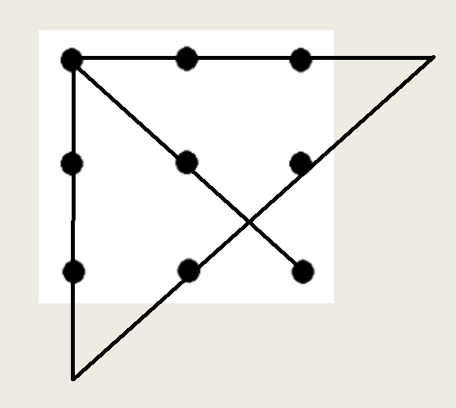

Slide 14
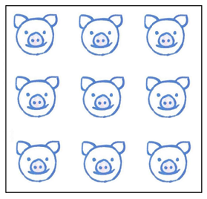
Build two more square enclosures so each pig is in a pen by itself.

Slide 15
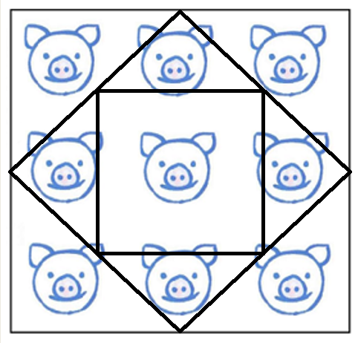

Slide 16
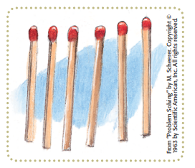
How would you arrange these six matches to form four equilateral triangles of all the same size, with no additional shapes left over?

Slide 17
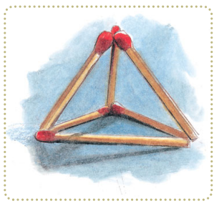

Slide 18

Draw two circles, one inside the other, with a single line and with neither circle touching the other (as shown below).

Slide 19
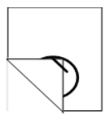
Draw the outer circle anywhere on the page.
When finished, fold a corner of the paper over so that it lies on top of the circle and the paper edge is beside your pen.
Move the pencil across this folded over edge to a point inside the circle you just drew.
Move the corner back to its original position and complete the second circle.

Slide 20

Cross out five letters so that the remaining letters, without altering their sequence, spell a familiar English word.

Slide 21

CREATIVE

Slide 22
Mental Set
Mental set: a tendency to approach a problem in one particular way, often a way that has been successful in the past.
Becoming stuck in a specific problem-solving strategy, inhibiting our ability to generate alternatives.
Obstacle to problem solving.

Slide 23
Functional Fixedness
Functional fixedness: tendency to think of things only in terms of their usual functions.
An obstacle to problem solving.
Inability to see problem from a fresh perspective.
Functional fixedness does not allow us to see objects, people, or concepts performing functions different from our fixed concepts.

Slide 24
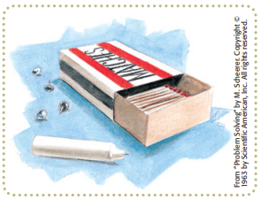
How would you mount the candle on a bulletin board?

Slide 25
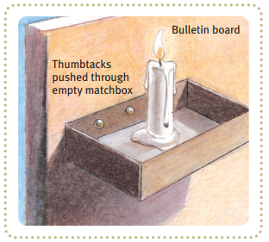

Slide 26
Problem Solving Techniques
Algorithm: a methodical, logical rule or procedure that guarantees solving a particular problem.
Step-by-step procedure to solve a problem.
Useful for when something has the same basic steps each time.
Contrasts with heuristics: heuristics are speedier but more error-prone than algorithms.

Slide 27
Problem Solving Techniques
Heuristic: a simple thinking strategy that often allows us to make judgments and solve problems efficiently.
Cognitive shortcuts for selecting among alternatives without carefully considering each one.
Allows for rapid and efficient but sometimes misleading judgments.
Fast but error prone.
Insight: a sudden and often novel realization of the solution to a problem.
Contrasts with strategy-based solutions.

Slide 28
N C N T G O I O I
O E M U D N T C
E I T T R N N E
E C N I M A H

Slide 29
Confirmation Bias
Tendency to search for or recall information that supports our preconceptions and to ignore/ distort contradictory evidence.
Downplay information that is contrary to your opinions.
Pay more attention to information that conforms to your opinions.
Leads to interpretation of ambiguous evidence as supporting existing opinions.
An obstacle to problem solving.

Slide 30
Confirmation Bias
The more emotionally involved you are, the more likely you will ignore facts or arguments to the contrary (polarization).
Biased search for information
Biased interpretation
Biased memory
The Most Common Cognitive Bias – YouTube
Belief perseverance: clinging to one’s initial conceptions after the basis on which they were formed has been discredited.

Slide 31
Analogical Reasoning Example
A person has an inoperable stomach tumor, but there are rays that can destroy the tumor. However, if the rays are of sufficient intensity to destroy the tumor, they will also destroy the healthy tissue they pass through. At lower levels of intensity, the rays will not harm healthy tissue but also will not destroy the tumor. How can one destroy the tumor with these rays and at the same time avoid harming the healthy tissue that surrounds the tumor?

Slide 32
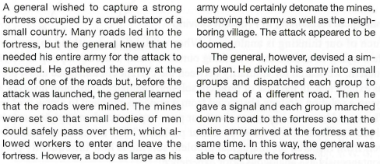

Slide 33
Analogical Reasoning
Analogical reasoning: when attempting to solve a problem, we search for similarity between current circumstance and a previous experience.
Gick & Holyoak (1980)
No participants were able to solve the tumor problem.
After receiving the fortress problem and solution, all the participants successfully solved the tumor problem.
In a later similar study, 20% of the participants figured out the solution.
Once presented with the analogous scenario, success rate shot up to 92%.

Slide 34
Decision Making
Decision making: process of making choices among one or more alternatives with the intention of moving toward some desired state of affairs.
Can be surprisingly complex.
Can involve big decisions.
Reliance on heuristics to make decisions quickly, which can lead to mistakes or show our biases.

Slide 35
Representativeness Heuristic
A man and his son are in a serious car accident. The father is killed and the son is rushed to the emergency room. Upon arrival, the attending doctor looks at the child and exclaims, “This is my son!”
Who is the doctor?

Slide 36
Representativeness Heuristic
Representativeness heuristic: judging the likelihood of things in terms of how well they seem to represent or match particular prototypes.
May lead us to ignore other relevant information.
Can involve use of stereotypes.

Slide 37
Representativeness Heuristic
A stranger tells you about a person who is short, slim, and likes to read poetry, and then asks you to guess whether this person is more likely to be a professor of classics at an Ivy League university or a truck driver. Which would be the better guess?

Slide 38

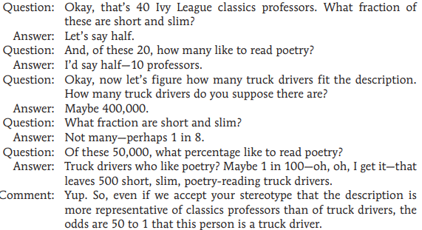

Slide 39
Representativeness Heuristic
Psychologists interviewed 30 engineers and 70 lawyers. One of them, Jack, is a 45 year old married man with four children.
He is generally conservative, cautious, and ambitious. He shows no interest in political and social issues and spends most of his free time on home carpentry, sailing, and solving mathematical puzzles. What is the probability that Jack is one of the 30 engineers in the sample of 100?

Slide 40
Availability Heuristic
Availability heuristic: estimating the likelihood of events based on their availability in memory.
If instances come readily to mind (perhaps because of their vividness), we presume such events are more common than they actually are.
Extreme examples get our attention and stick with us.
https://www.youtube.com/watch?v=lhRVHAFaTiU
First instinct fallacy

Slide 41
Overconfidence Bias
Overconfidence: tendency to be more confident than correct.
Overestimating the accuracy of our beliefs and judgments.
Overestimating our performance or abilities.
Can lead to lack of preparation or putting self in situations that one is not well-equipped to handle.
Dunning-Kruger Effect: when people with low ability, expertise, or experience overestimate their knowledge.
Often spoken about in the context of metacognition.

Slide 42
Metacognition
Metacognition: a person’s cognition about cognitive phenomena.
Your awareness and understanding of what you know and what you don’t know.
The more accurately an individual evaluates learning and retrieval, the more effective at controlling it.
Stronger meta-cognition can reduce overconfidence bias.

Slide 43
You are near graduating and entering your final semester of college. You want to make sure to maintain your GPA, so you are being especially careful about which classes to enroll in so as to not lower your GPA.
As you consider which courses to take, you see that in one of the classes, 20% of the students got As last semester. Do you enroll in this class?
As you consider which courses to take, you see that in one of the classes, 80% of the students did not receive As last semester. Do you enroll in this class?

Slide 44
You are trying to cut down on your sugar intake but have a craving for cookies.
At the grocery store, you find a box of cookies that are 90% sugar-free. Would you buy this box of cookies?
At the grocery store, you find a box of cookies that are described as having 10% sugar. Would you buy this box of cookies?

Slide 46
Framing
Framing
The way an issue is posed.
How an issue is framed can significantly affect decisions and judgments.
Sunk Cost Effect
The willingness to do something undesirable because of money or effort already spent.

Slide 48
Anchoring Heuristic
Anchoring heuristic: an educated guess in which the starting point has a strong influence on the conclusion that is ultimately reached.
Used in marketing/ sales.

Slide 49
Other Heuristics & Biases
Affect heuristic: an educated guess in which the worth of something is strongly influenced by how a person feels toward it.
Hindsight bias: tendency to overestimate how well we could have predicted something after it has occurred.
Intuition: implicit (unconscious) knowledge that we cannot fully explain.

Slide 50
Intuition
A bat and a ball together cost 110 cents. The bat costs 100 cents more than the ball. How much does the ball cost?

Slide 51
Intuition
Answer: 5 cents.
Bat costs $1.05 and ball costs 5 cents, for a total of $1.10.
If the ball cost the intuitive answer of 10 cents, the bat would then have to cost $1.10, for a total of $1.20.

Slide 52
Intuition
Emily’s father has three daughters. The first two are named April and May. What is the third daughter’s name?

Slide 53
Intuition
Answer: Emily.

Slide 54
Intuition
There are some students in a room.
All but two of them are psychology majors, all but two are chemistry majors, and all but two are history majors. How many students are present?

Slide 55
Intuition
Answer: Three students. One psychology major, one chemistry major, and one history major.

Slide 56
Dual Process Theory
Dual process theory: the notion that every person possesses two separate types of thinking, one automatic and one deliberate.
Decision-making can involve either automatic or effortful processes.

Slide 57
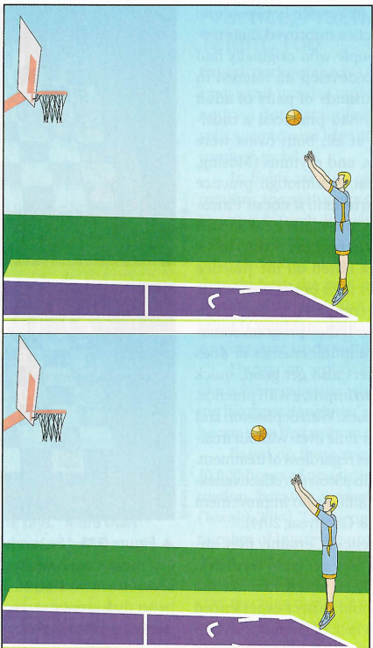
Will the ball go in the basket?
Will the ball go in the basket?

Slide 58
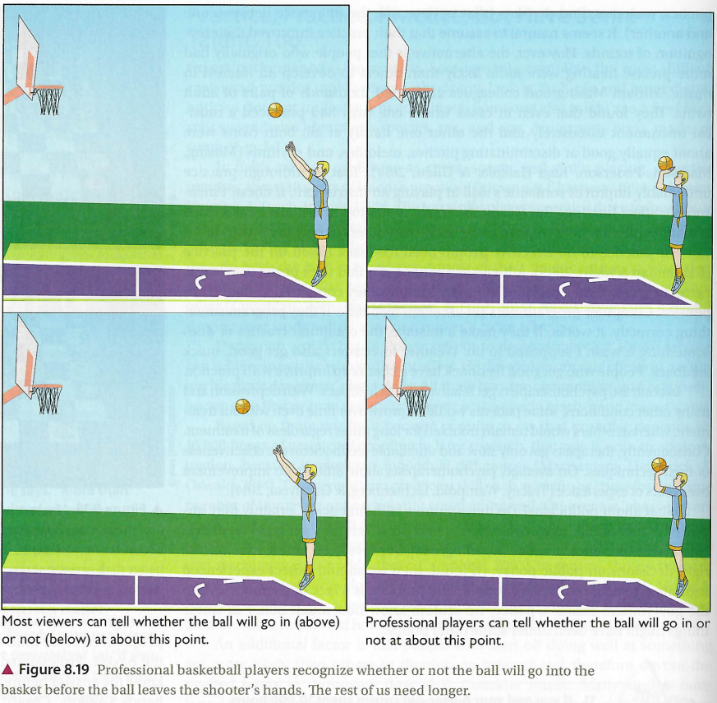

Slide 59
Dual Process Theory
Automatic processing
Instantaneous, effortless, often without full awareness.
May fall back on heuristics, intuition.
Useful for emotional preferences.
Often used for quick decision making (e.g. first impressions, emergencies).

Slide 60
Dual Process Theory
Conscious processing
Slow, deliberate, purposeful.
Takes more time and effort, but can be more accurate.
Better for evaluating scientific claims or choices where there are objectively more optimal or less optimal choices.

Slide 61
Winter Survival Activity

Slide 62
Dual Process Theory
Maximizer vs. Satisficer Survey.
Maximizing: thoroughly considering all available choices to find the best one.
Satisficing: searching only until you find something satisfactory.
Cognitive miser: seeking out quick, adequate solutions to problems rather than slow careful ones.
Humans tend to rely on shortcuts.
“Good enough” instead of “best.”
Too many options can hinder decision making.

Slide 63

Creativity
Creativity: the ability to produce novel and valuable ideas.
Creative Process Model
Preparation: defining the problem.
Incubation: reflective thought.
Verification: conscious evaluation and experimentation.

Slide 64
Creativity
Convergent thinking: problem solving strategy in which a person uses logic to deduce the single best solution.
Best suited for tasks that involve logic.
Divergent thinking: problem solving strategy in which a person comes up with lots of different possible solutions.
Usually associated with creativity.
Brainstorming, outside-the-box thinking.
Must overcome mental sets, functional fixedness.

